Slide 1
V. A. Mocarts
,,Don Giovanni”
,,Dons Žuāns”

Slide 2
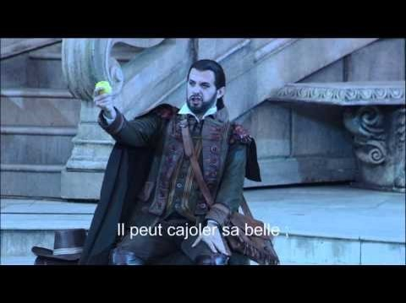
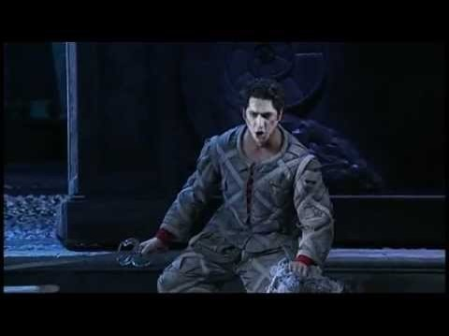
,,Notte e giorno faticar”
Leporello dziedājums
https://www.youtube.com/watch?v=6g_yYgNj-YU
https://www.youtube.com/watch?v=GGPp6ghdIeM

Slide 3
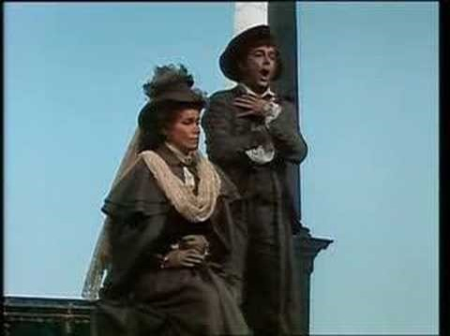
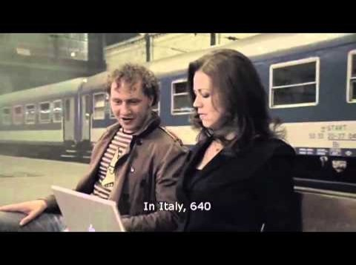
,, Madamina il catalogo è questo”
Leporello ārija
https://www.youtube.com/watch?v=fCah83LOF9M
https://www.youtube.com/watch?v=OqeyElCHRM8
Notes:
3

Slide 4
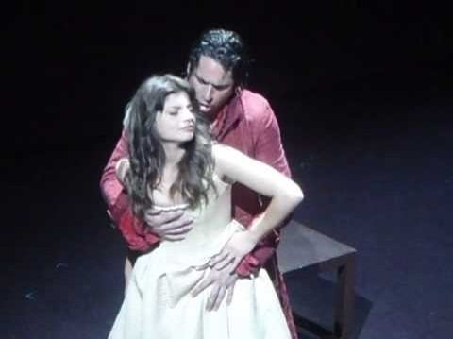
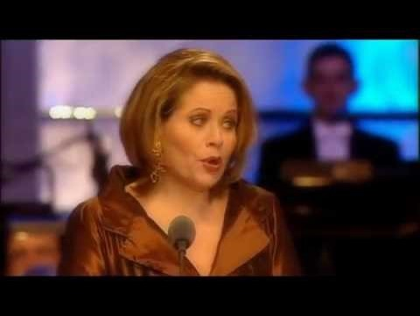
,, là ci darem la mano “
Dona Žuāna un Cerlīnas duetīno
https://www.youtube.com/watch?v=ffs6bThByWw
https://www.youtube.com/watch?v=xx1DLnPULUk

Slide 5
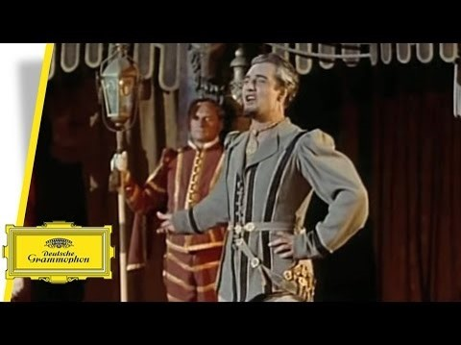
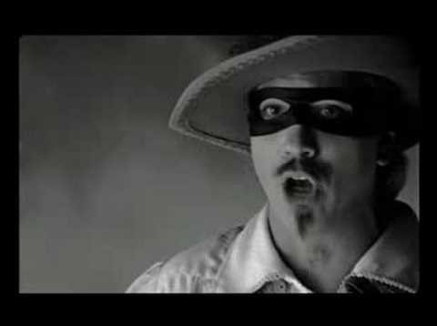
,, Don Giovanni - Fin ch'han dal vino”
Dona Žuāna ārija
https://www.youtube.com/watch?v=KFHyyVcsRQA
https://www.youtube.com/watch?v=WTT2RkrBsAs

Slide 6
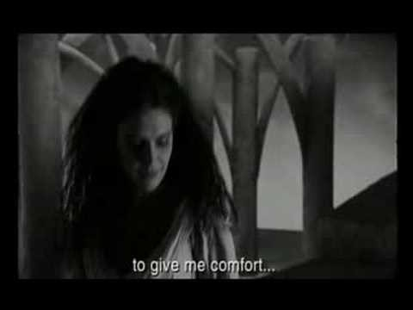
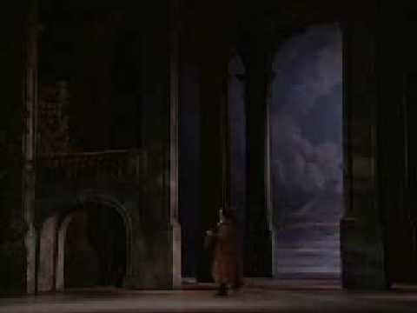
,, Deh vieni alla finestra”
Dona Žuāna serenāde
https://www.youtube.com/watch?v=A6MLEumcr_k
https://www.youtube.com/watch?v=t2vnjUX_Dns

Slide 7
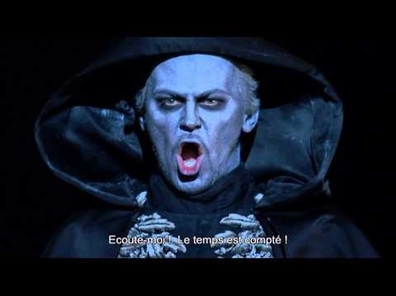
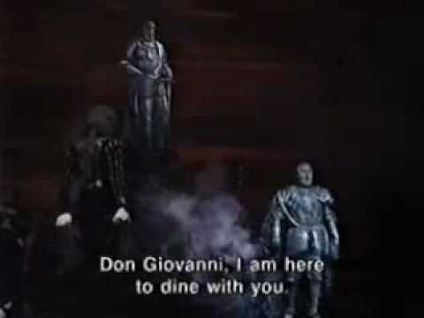
Finale
Fināls
https://www.youtube.com/watch?v=FEVD9Yq9qF8
https://www.youtube.com/watch?v=7cb1QmTkOAI
Notes:
7

Slide 8
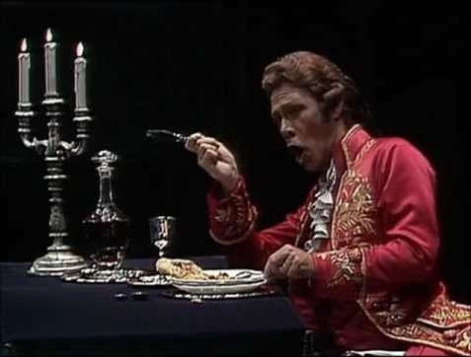
Balles skats
Citāti
https://www.youtube.com/watch?v=l-j8EtweQzs

Slide 9
Visa opera
https://www.youtube.com/watch?v=uE2l7YeERjk
Balle, dejas, trīs orķestri
1, 27’ 7’’

